Slide 1


Slide 2

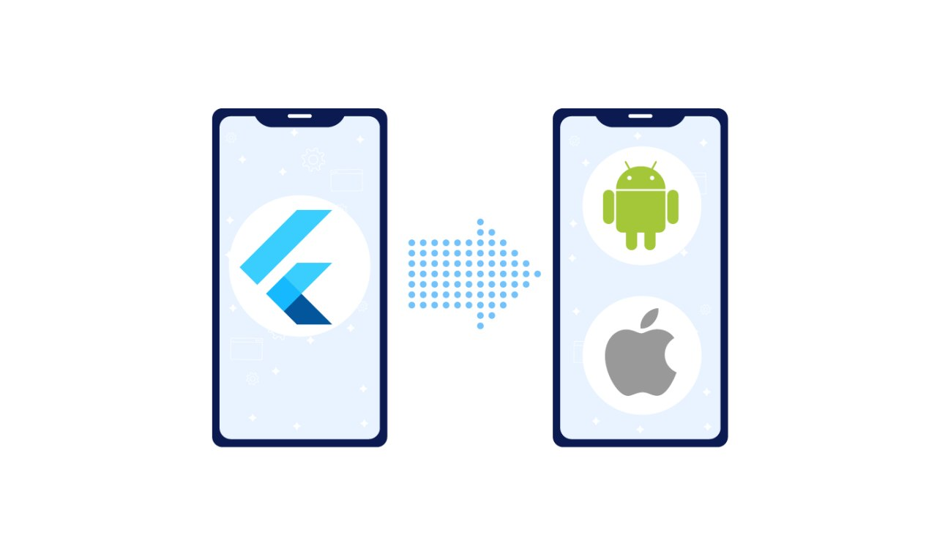
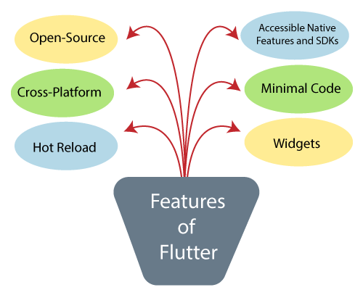
Flutter Features

Slide 3
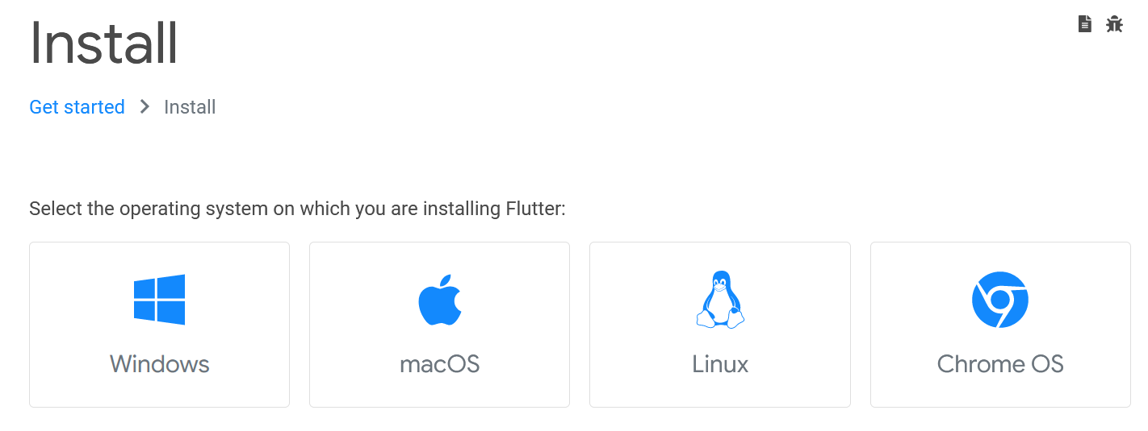
Flutter Installation

Slide 4

Install Android Studio
Get the official Integrated
Development Environment (IDE)
for Android app development.

Slide 5
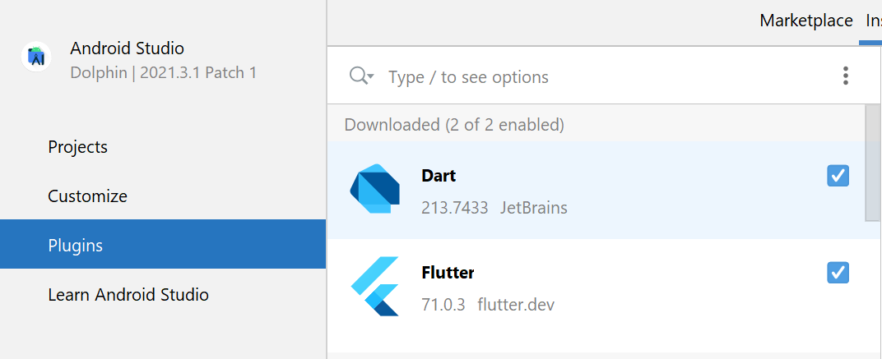
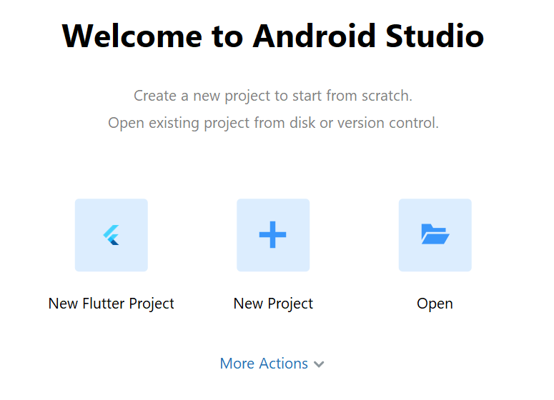
Install Flutter Extensions

Slide 6
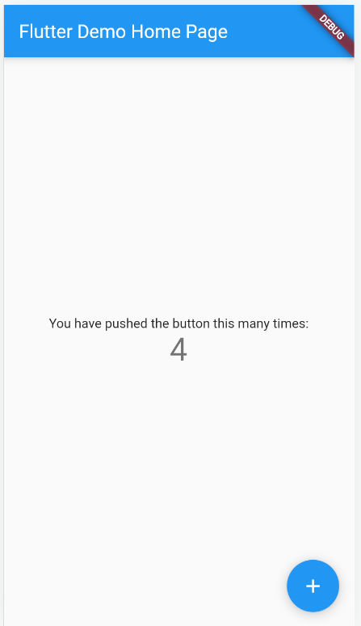
Create & Run Your First Flutter App

Slide 7
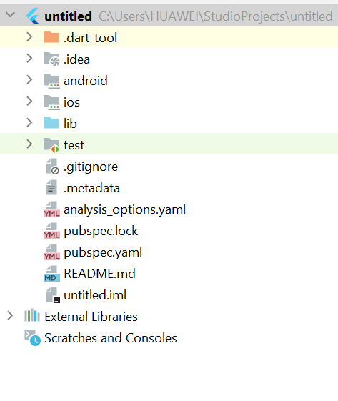
Flutter Project Structure
.idea:
This folder is at the very top of the project structure.
Holds the configuration for Android Studio.
It doesn't matter because we are not going to work with.
So that the content of this folder can be ignored.
.android:
This folder holds a complete Android project
Used when you build the Flutter application for Android
When the Flutter code is compiled into the native code
It will get injected into this Android project
That the result is a native Android application

Slide 8
Flutter Project Structure
.ios:
This folder holds a complete Mac project
used when you build the Flutter application for iOS
When the Flutter code is compiled into the native code
It will get injected into this iOS project
that the result is a native iOS application
Building a Flutter application for iOS is only possible when you are working on macOS

Slide 9
Flutter Project Structure
lib:
It is an essential folder, which stands for the library
It is a folder where we will do our 99 percent of project work
Inside the lib folder, we will find the Dart files which contain the code of our Flutter application
By default, this folder contains the file main.dart, which is the entry file of the Flutter application.

Slide 10
Flutter Project Structure
test:
This folder contains a Dart code,
Which is written for the Flutter application.
Perform the automated test when building the app.
It won't be too important for us here.

Slide 11
Flutter Project Structure
.gitignore:
It is a text file containing a list of files, file extensions, and folders
that tells Git which files should be ignored in a project.
Git is a version-control file for tracking changes in source

Slide 12
Flutter Project Structure
.metadata:
It is an auto-generated file by the flutter tools.
Used to track the properties of the Flutter project.
This file performs the internal tasks.
So you do not need to edit the content manually at any time.

Slide 13
Flutter Project Structure
pubspec.yaml:
It is the project's configuration file that will use a lot during working with the Flutter project. It allows you how your application works. This file contains-
Project general settings such as name
Description, and version of the project.
Project dependencies.
Project assets (e.g., images).

Slide 14
Flutter Project Structure
pubspec.lock:
It is an auto-generated file based on the .yaml file.
It holds more detail setup about all dependencies.

Slide 15
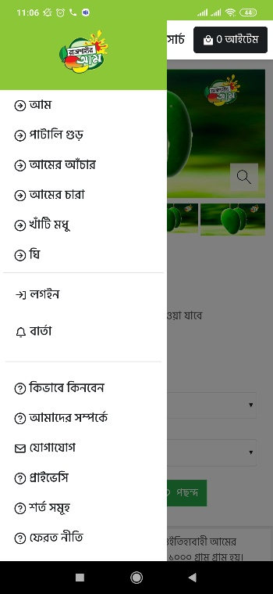
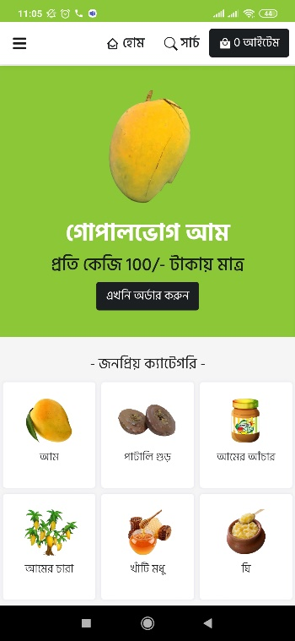
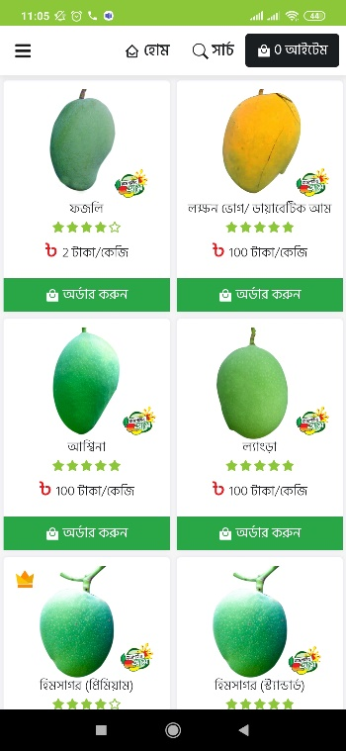
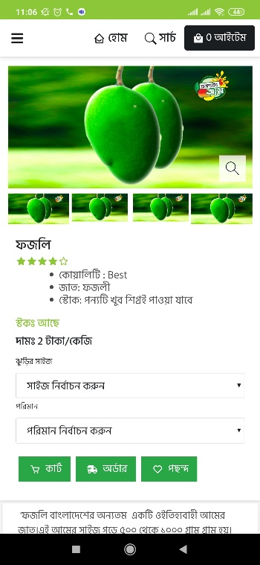
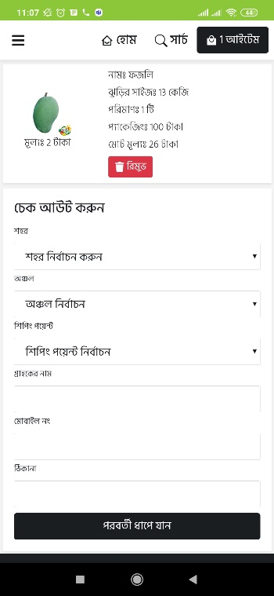
Activity & widgets concepts

Slide 16
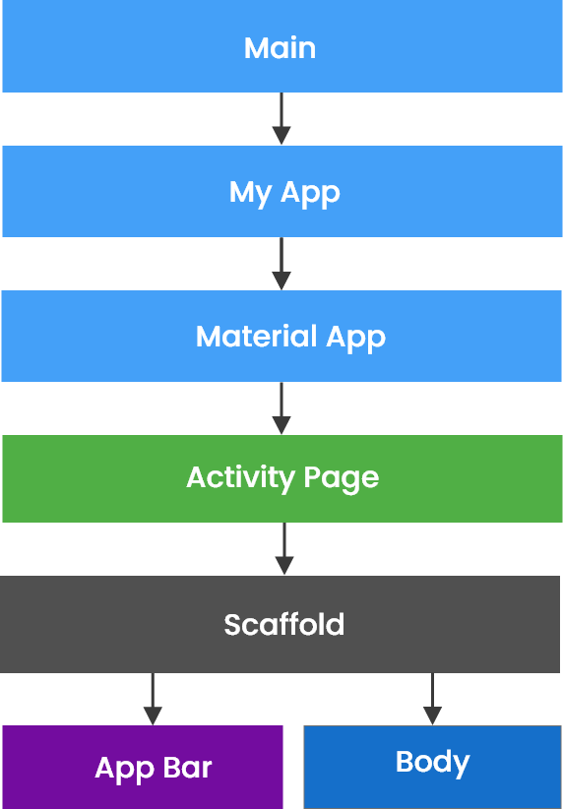
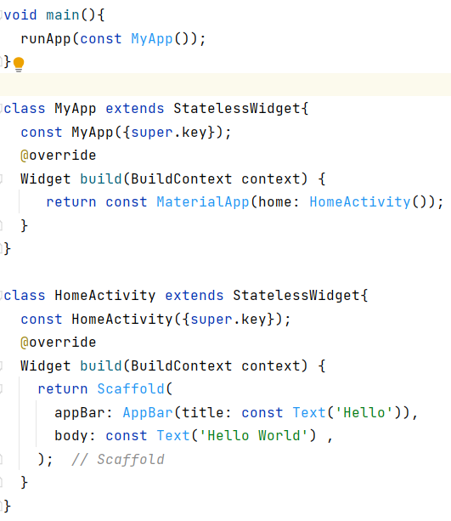
Flutter Main Source Code Flow

Slide 17
Material App Class
MaterialApp is a predefined class in a flutter. Main or core component of flutter.
color: It controls the primary color used in the application.
darkTheme: It provided theme data for the dark theme for the application.
debugShowCheckedModeBanner: This property takes in a boolean as the object to decide whether to show the debug banner or not.
home: This property takes in widget as the object to show on the default route of the app.
title: The title property takes in a string as the object to decide the one-line description of the app for the device.

Slide 18
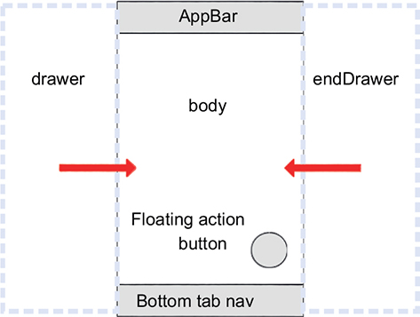
Scaffold Class
Scaffold will expand or occupy the whole device screen.

Slide 19
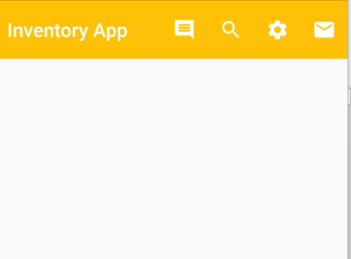
Flutter AppBar Widget
AppBar is usually the topmost component of the app . it contains the toolbar and some other common action buttons.
actions: This property takes in a list of widgets as a parameter to be displayed after the title if the AppBar is a row.
title: This property usually takes in the main widget as a parameter to be displayed in the AppBar.
backgroundColor: This property is used to add colors to the background of the Appbar.
elevation: This property is used to set the z-coordinate at which to place this app bar relative to its parent.
shape: This property is used to give shape to the Appbar and manage its shadow.

Slide 20
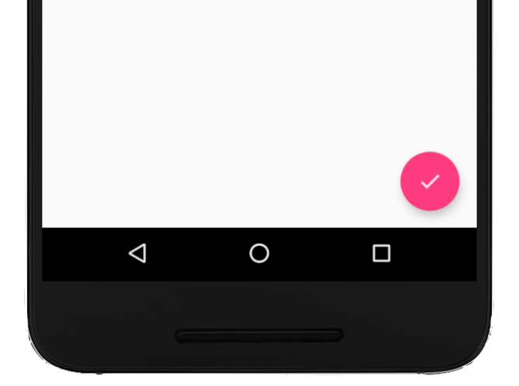
Flutter Floating Action Button
Floating Action Button is a button that is placed at the right bottom corner by default.
Floating Action Button is an icon button that floats over the content of the screen at a fixed place.

Slide 21
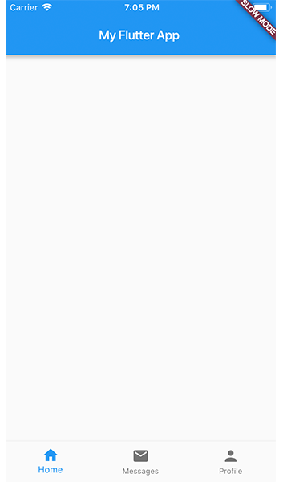
Flutter Bottom Tab
Menu at the bottom of the Scaffold.
We have seen this Navigation bar in most of the applications.
We can add multiple icons or texts or both in the bar as items.

Slide 22
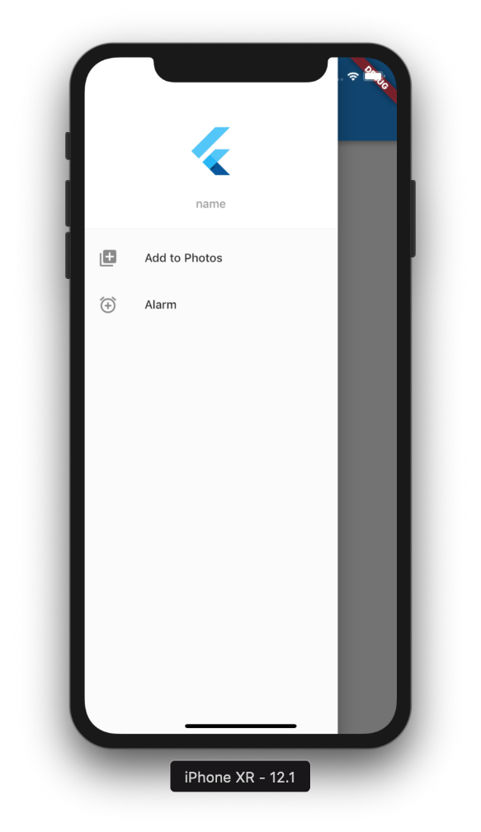
Navigation drawer flutter

Slide 23
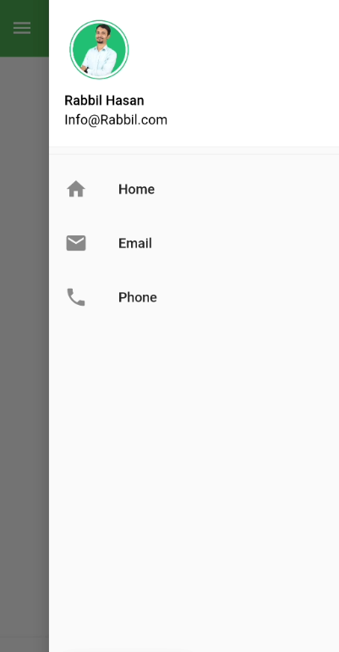
Navigation end drawer flutter

Slide 24
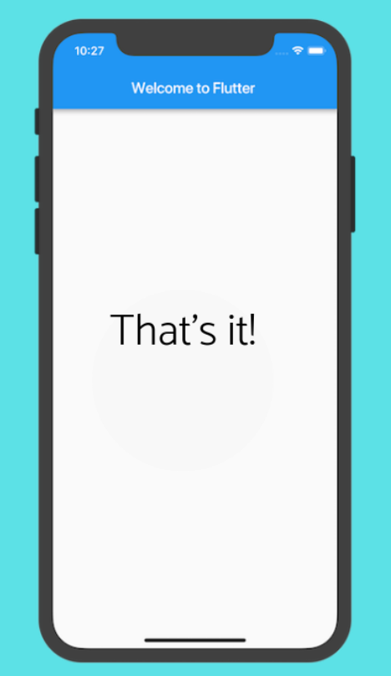
Flutter Body

Slide 25
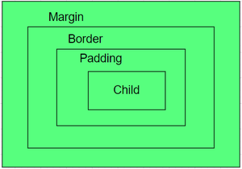
Container in Flutter
Container class in flutter is a convenience widget that combines common painting, positioning, and sizing of widgets.

Slide 26
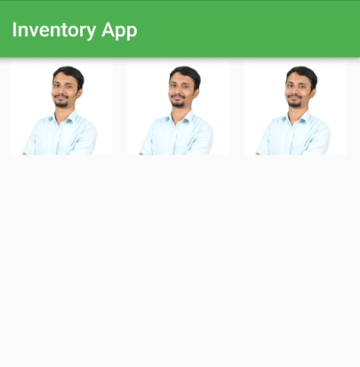
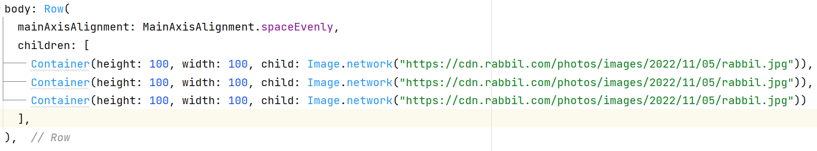
Flutter Row With Container

Slide 27
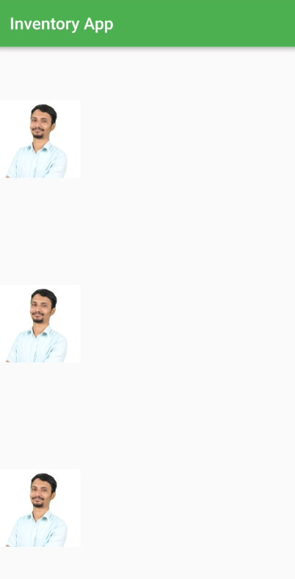
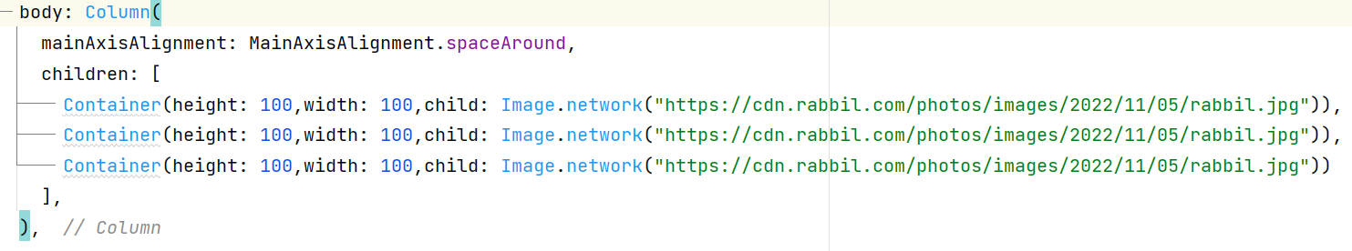
Flutter Column With Container

Slide 28
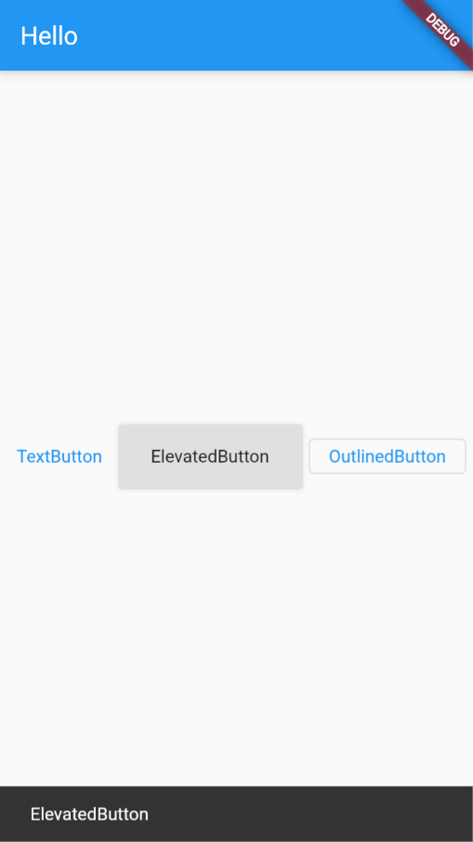
Flutter Button
Elevated Button
Text Button
Outline Button

Slide 29
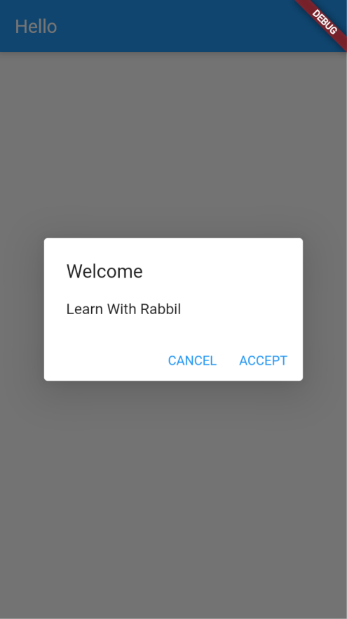
Alert Dialog

Slide 30
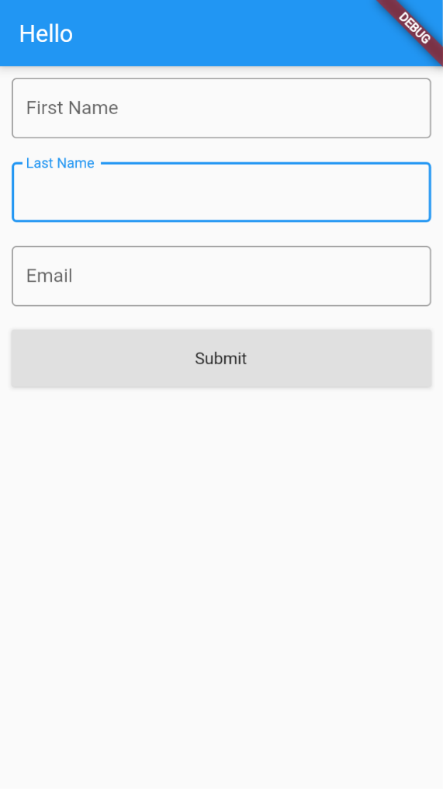
Simple Form

Slide 31
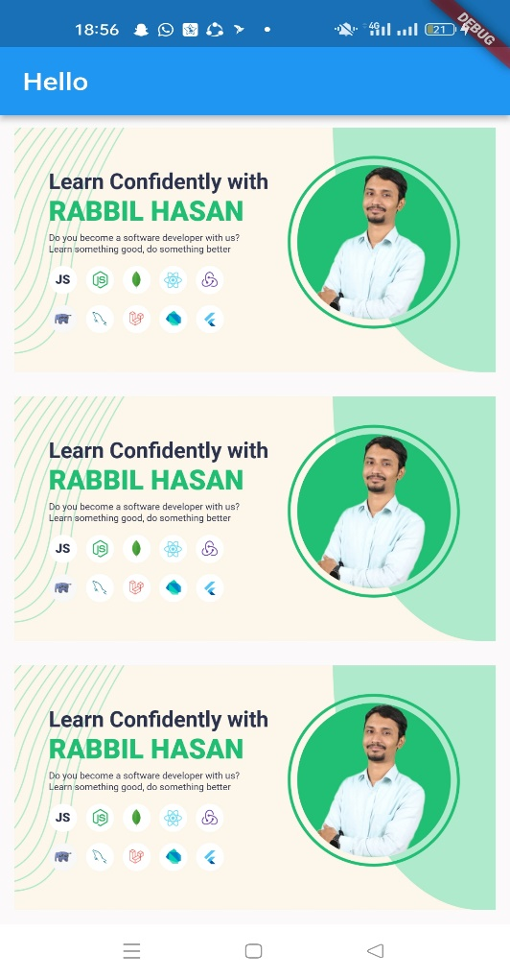
List View Builder From Array
Step 01: JSON Array
Step 02: List View Builder
Step 03: Gesture Detector
Step 04: List Item
Step 05: List Item On Tap/On Press

Slide 32
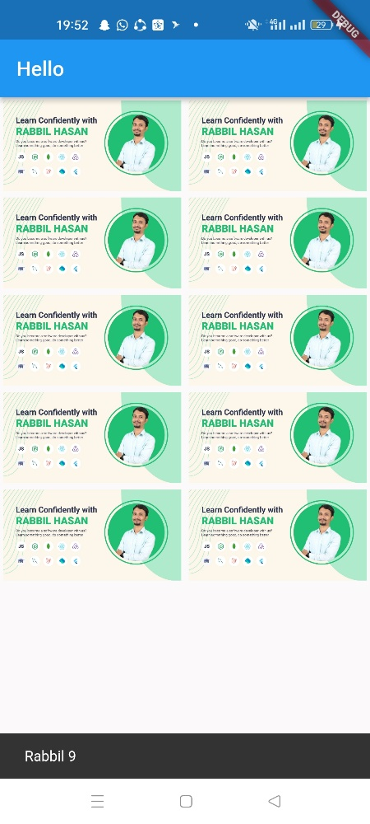
Grid View Builder From Array
Step 01: JSON Array
Step 02: Grid View Builder
Step 03: Gesture Detector
Step 04: Grid Item
Step 05: Grid Item On Tap/On Press

Slide 33
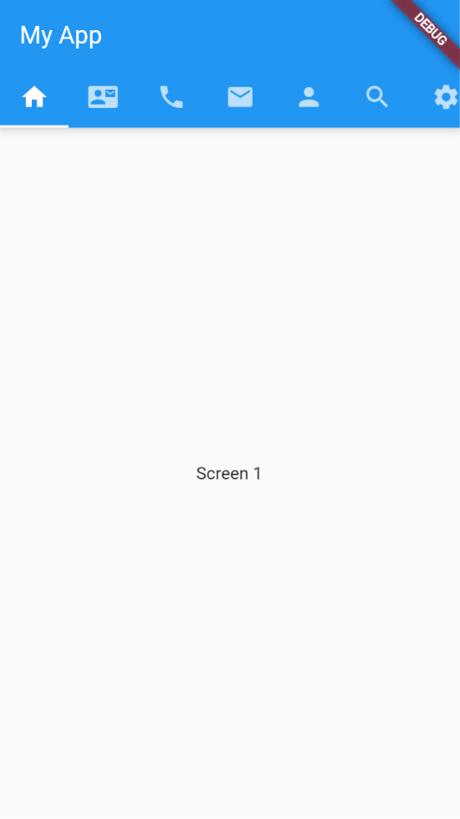
Tab Bar / Activity/ Fragment

Slide 34
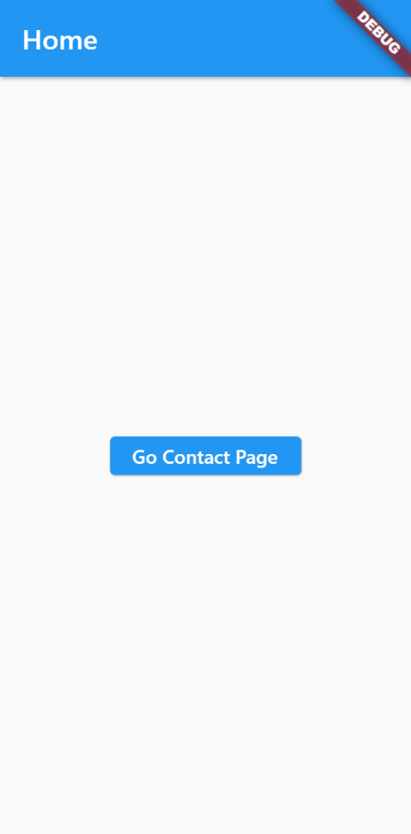
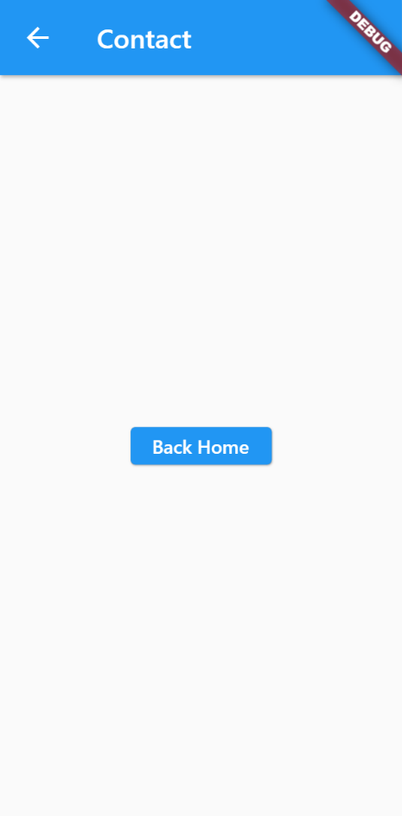
Navigation

Slide 35
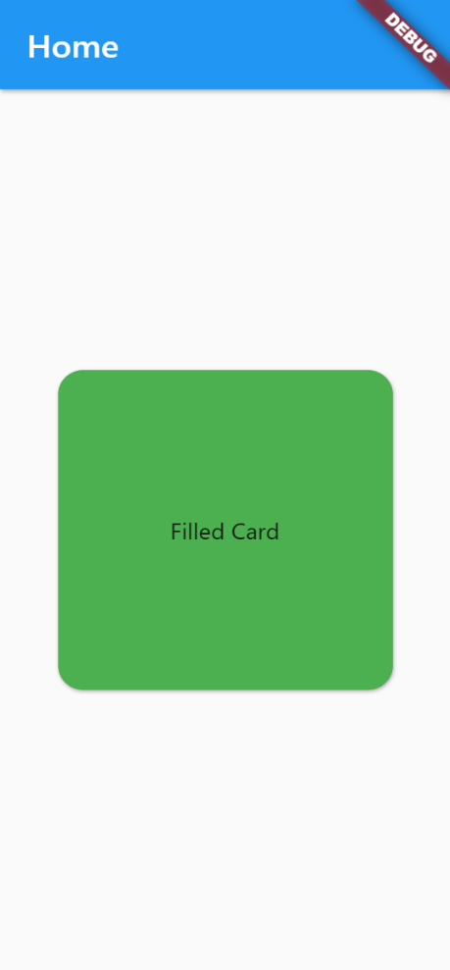
Working With Card Shape

Slide 36
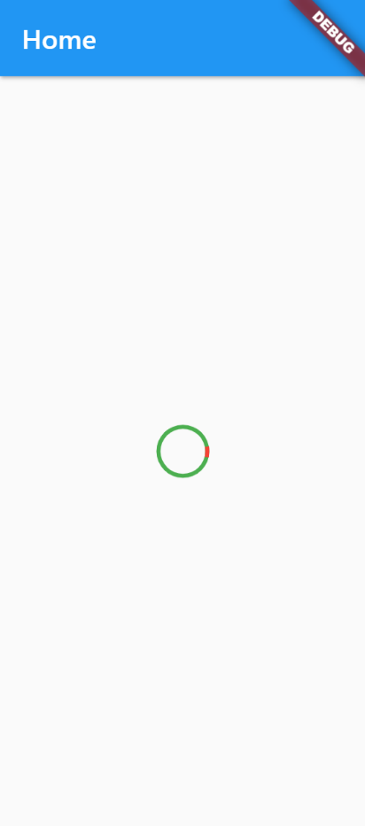
Working With Circular progress

Slide 37
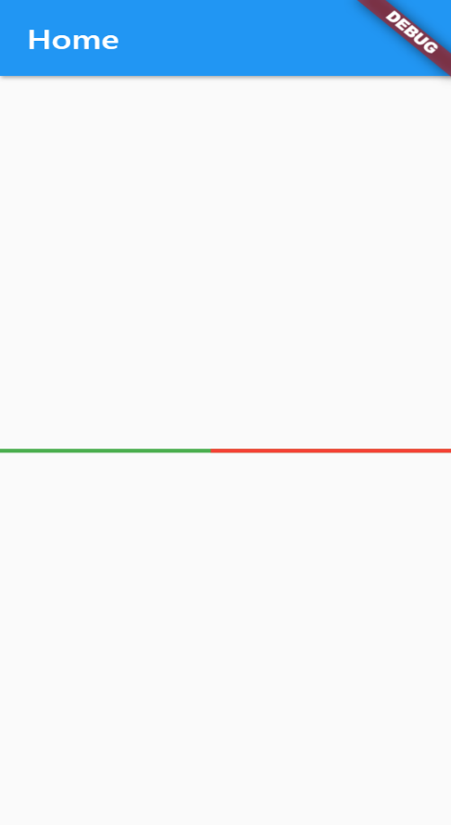
Working With Linear progress

Slide 38
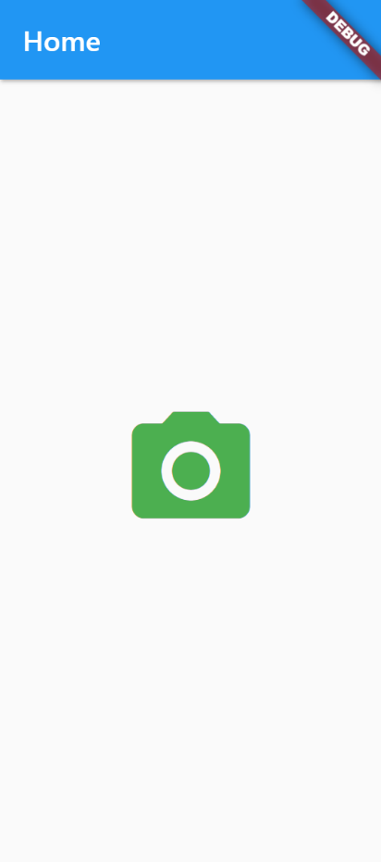
Icons Class In Flutter

Slide 39
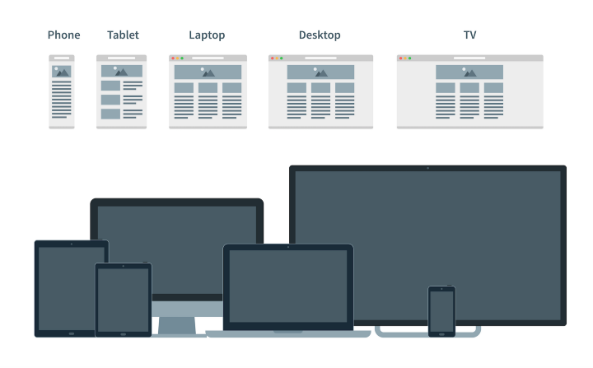
Responsive & Adaptive
Why?
It is impossible to keep in mind all devices, client may use for the application using.
Adaptive design and responsive design were created to avoid the classification.
Actually, AD (adaptive design) and RD (responsive design) solve the same tasks but in different ways.

Slide 40
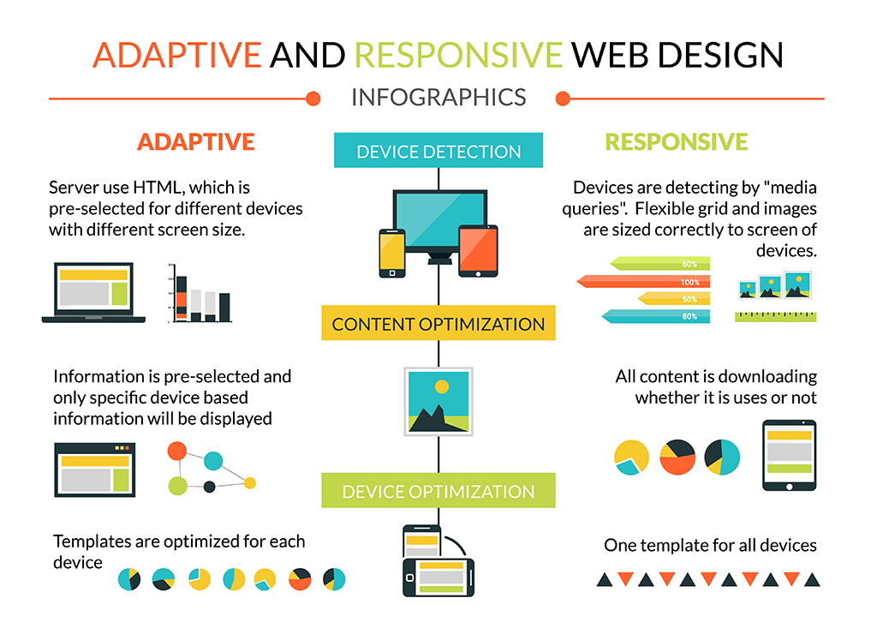
Responsive vs Adaptive

Slide 41
Responsive & Adaptive For Flutter Application
Why?
To take the maximum advantages from Flutter
To enable your application in different size device with web & desktop too.
Widgets & Packages:
Fractionally Sized Box
Media Query
Expanded
Aspect Ratio
Fitted Box
Layout Builder
Responsive grid
Column Row
Responsive Framework
Scroll View

Slide 42
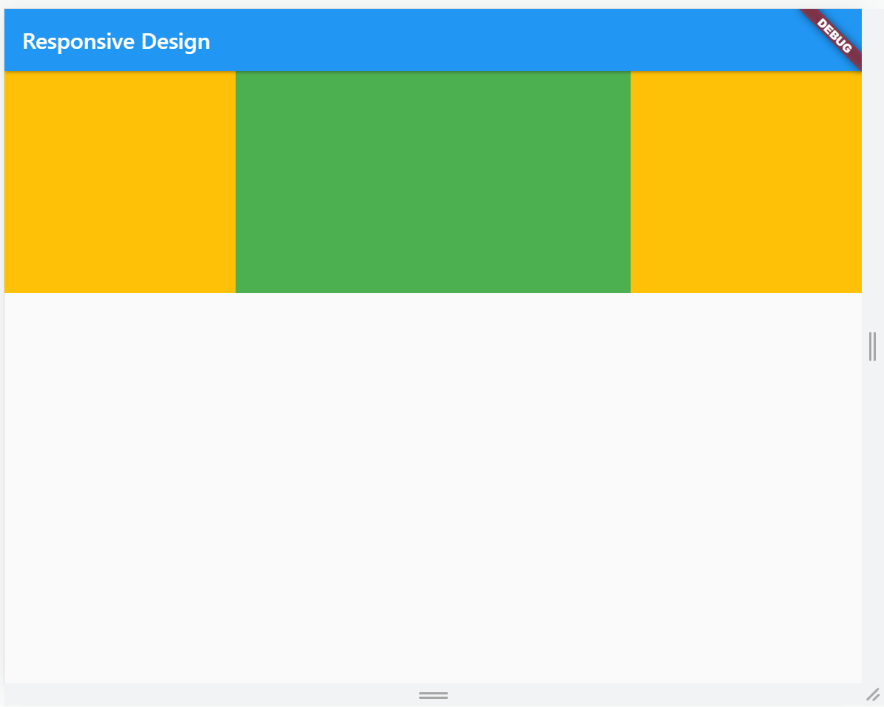
Aspect Ratio
A widget that attempts to size the child to a specific aspect ratio
The widget first tries the largest width permitted by the layout constraints.
The height of the widget is determined by applying the given aspect ratio to the width

Slide 43

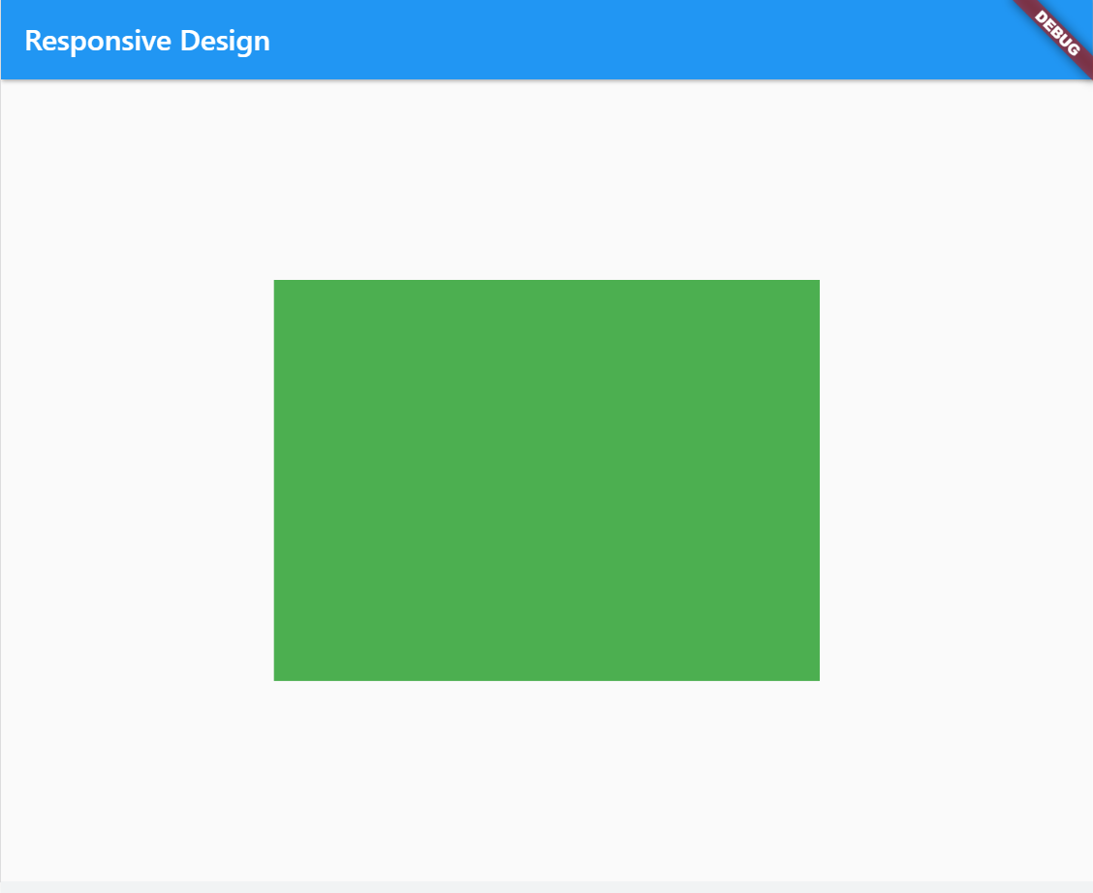
Fractionally Sized Box
A widget that sizes its child to a fraction of the total available space.

Slide 44
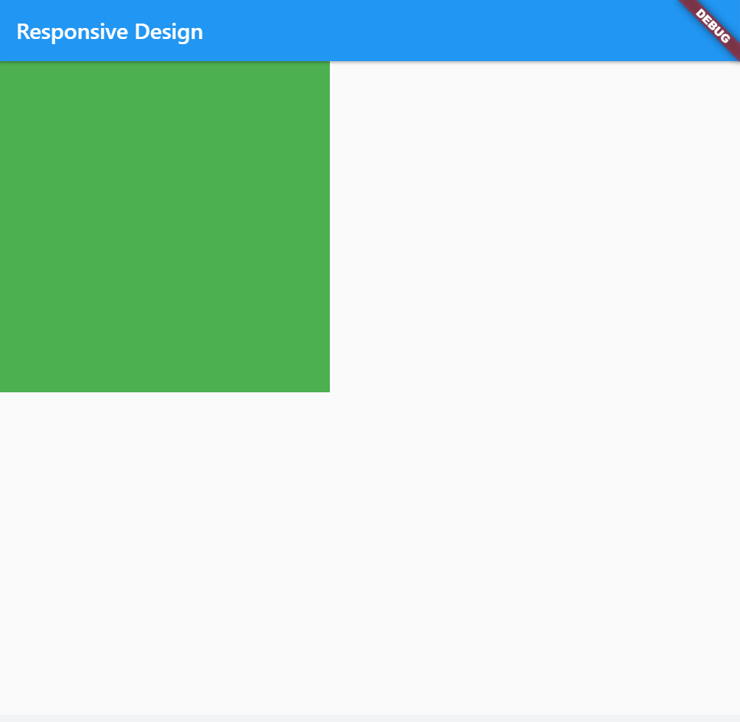
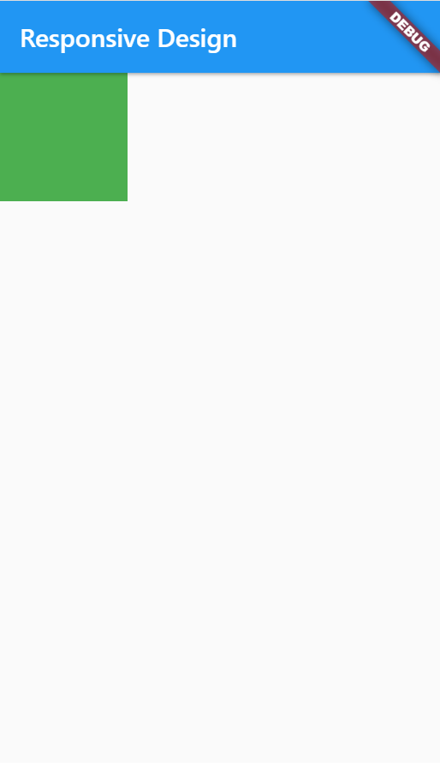
Layout Builder
Builds a widget tree that can depend on the parent widget's size

Slide 45
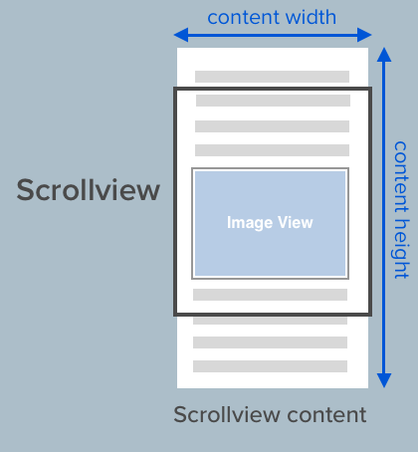
Scroll View

Slide 46
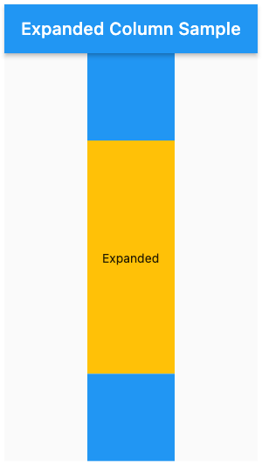
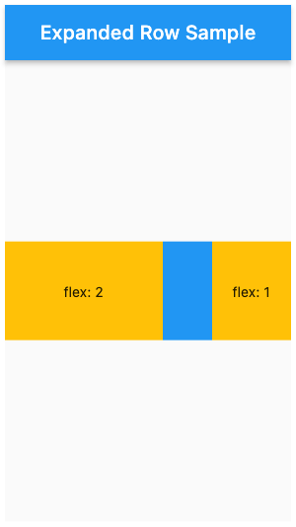
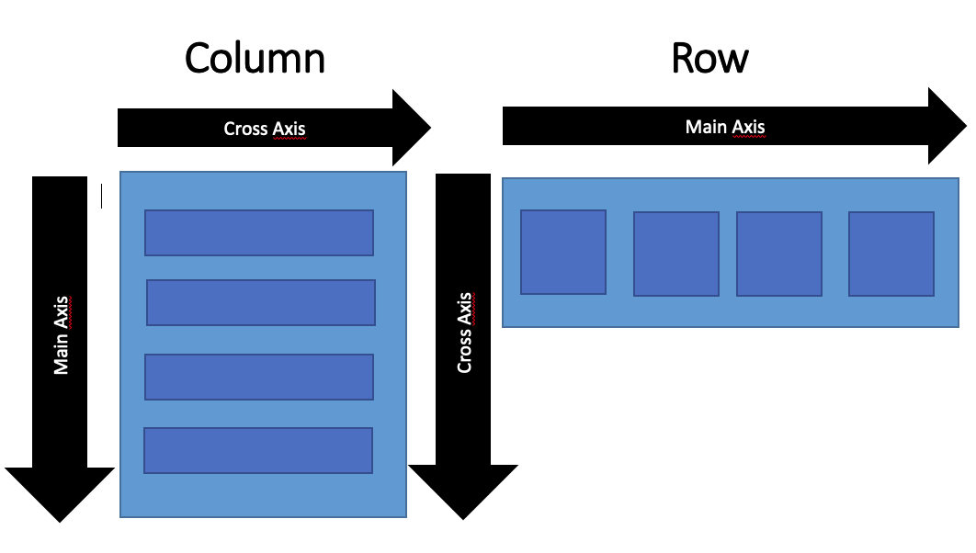
Expanded & Flexible

Slide 47
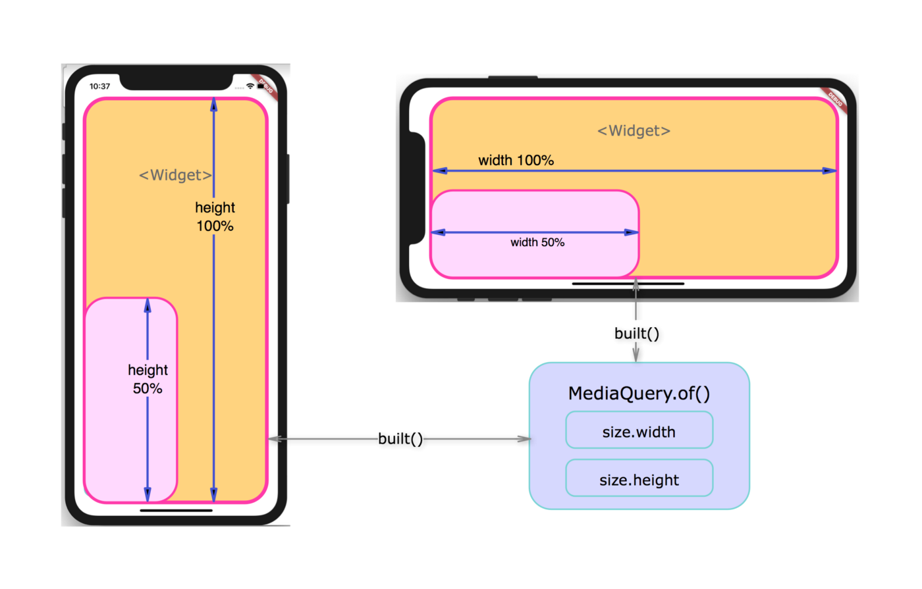
Media Query

Slide 48
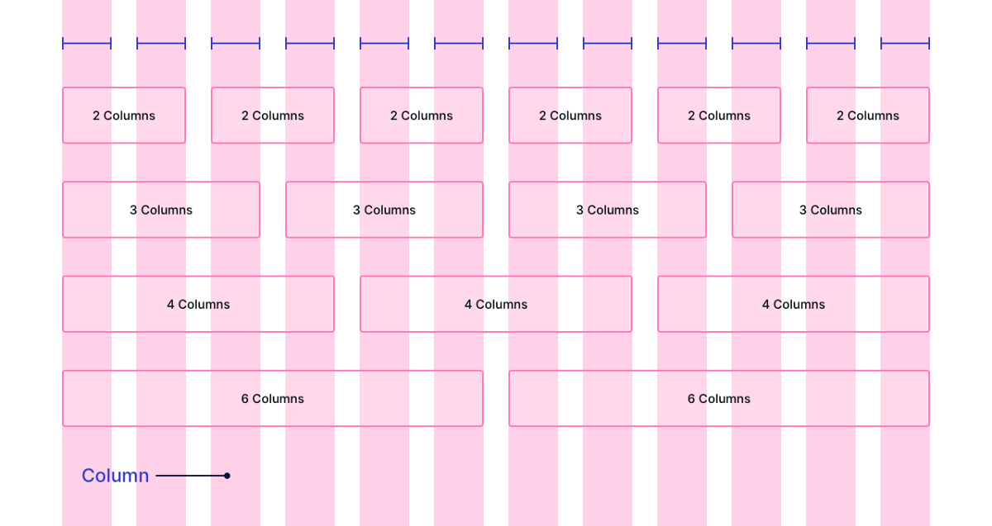
Responsive Grid

Slide 49

Stateful Widget

Slide 50


State
First Gear
Pickup Increase
Second Gear
Pickup Increase
Third Gear
Forth Gear
Gear Shift Down
Pickup Decrease

Slide 51
State
What is state:
Anything that exists in the memory of the app while the app is running.
When state values change, view update automatically

Slide 52

Stateless & Stateful

Slide 53

Stateless & Stateful

Slide 54

How Stateful Widget Works

Slide 55

How Stateful Widget Works

Slide 56
Lets Create Our First Stateful Widget

Slide 57
State Lifecycle methods
The Stateful widget is mutable
It can be change multiple times within its lifetime.
So we need to understand it's lifecycle

Slide 58
State Lifecycle methods
createState()
This method creates a State object. This object is where all the mutable state for that widget is held.
This step is not marked as a real step in the lifecycle, but it is important to know what is going on in the background.

Slide 59
State Lifecycle methods
initState()
Automatically called only once, when the state object is created for the first time.
Use this method to manage HTTP requests and subscribe to streams or any other object that could change the data on this widget.

Slide 60
State Lifecycle methods
didChangeDependencies()
Framework will call this method immediately after the initState().
The build method is always called after this method, so this method is rarely needed

Slide 61
State Lifecycle methods
build()
it will be called many times during the lifecycle, but the first time is after the didChangeDependencies() method.
Whenever the widget that belongs to the state is updated, the framework will always execute this method

Slide 62
State Lifecycle methods
setState()
The setState() method notifies the framework that the internal state of the current object is changed, now it's time to update the view

Slide 63

Lets Create A Counter App

Slide 64

Lets Create Sum Calculator

Slide 65

Lets Create To do list

Slide 66

Flutter With Web Rest API

Slide 67



Introduction to Rest API
Representational State Transfer
Server Script /
API Script
Client Script
Database

Slide 68

Postman

Slide 69
Rest API practices
Best practices of json
Request response model
Rest API working flow
Postman & Documentation

Slide 70
Practices of JSON
JavaScript Object Notation (JSON)
JSON is a lightweight data-interchange format that is completely language independent.
It was derived from JavaScript, but many modern programming languages include code to generate and parse JSON-format data
The official Internet media type for JSON is application/json.
It was designed for human-readable data interchange.
The filename extension is .json.

Slide 71
Practices of JSON
Uses of JSON
It is used while writing JavaScript based applications that includes browser extensions and websites.
JSON format is used for serializing and transmitting structured data over network connection.
It is primarily used to transmit data between a server and web applications.
Web services and APIs use JSON format to provide public data.

Slide 72
Practices of JSON
Characteristics of JSON
JSON is easy to read and write.
It is a lightweight text-based interchange format.
JSON is language independent.

Slide 73

Practices of JSON
Understanding JSON Structure

Slide 74
Practices of JSON
JSON - Data Types
Type | Description
Number | Double- precision floating-point format in JavaScript
String | Double-quoted Unicode with backslash escaping
Boolean | True or False
Array | An ordered sequence of values
Value | It can be a string, a number, true or false, null etc
Object | An unordered collection of key:value pairs
Whitespace | Can be used between any pair of tokens
null | Empty

Slide 75

Practices of JSON
Always enclose the Key : Value pair within double quotes

Slide 76

Practices of JSON
Never use Hyphens in your Key fields

Slide 77
Practices of JSON
Bad Special Characters & Solution
Characters | Replace with
Backspace | \b
Form feed | \f
Newline | \n
Carriage return | \r
Tab | \t
Double quote | \"
Backslash | \\

Slide 78

Practices of JSON
Bad Special Characters And Solution

Slide 79


Practices of JSON
Always create a Root element.

Slide 80

Request Response Model
HTTP/HTTPS Request Response Communication
In request/response communication mode.
One software module sends a request to a second software module and waits for a response.
The First software module performs the role of the client.
The second, the role of the server,
This is called client/server interaction.

Slide 81

Request Response Model
Application Level Client :
HTTP Client is an application library used in client side application to generate request and receive response.
HTTP Client’s libraries varies from platform to platform.

Slide 82
Request Response Model
HTTP Request
HTTP Request is the first step to initiate web request/response communication. Every request is a combination of
request header, body and request URL.
Http Request Segments
Request Area | Standard Data Type
Body | Simple String, JSON, Download, Redirect, XML
Header | Key Pair Value
URL Parameter | String

Slide 83
Request Response Model
HTTP Request Methods:
Method Name | Responsibilities
GET() | The GET method is used to retrieve information from the given server using a given URI. Requests using GET should only retrieve data and should have no other effect on the data.
Head() | Same as GET, but transfers the status line and header section only.
POST() | A POST request is used to send data to the server, for example, customer information, file upload, etc. using HTML forms.
PUT() | Replaces all current representations of the target resource with the uploaded content.
DELETE() | Removes all current representations of the target resource given by a URI.

Slide 84
Request Response Model
Request Compare GET vs. POST:
Key Points | GET | POST
BACK button/Reload | Harmless | Data will be re-submitted (the browser should alert the user that the data are about to be re-submitted)
Bookmarked | Can be bookmarked | Cannot be bookmarked
Cached | Can be | Never
Encoding type | application/x-www-form-urlencoded | application/x-www-form-urlencoded or multipart/form-data. Use multipart encoding for binary data
History | Parameters remain in browser history | Parameters are not saved in browser history
Restrictions on data length | Yes, when sending data, the GET method adds the data to the URL; and the length of a URL is limited (maximum URL length is 2048 characters) | No restrictions

Slide 85
Request Response Model
HTTP Response:
Http response is the final step of request-response communication. Every response is a combination of response header, body an d cookies.
Http Response Segments:
Response Area | Standard Data Type
Body | Simple String, JSON, Download, Redirect, XML
Header | Key Pair Value
Cookies | Key Pair Value

Slide 86
Request Response Model
HTTP Response status messages
Code | Meaning | Description
200 | OK | The request is OK (this is the standard response for successful HTTP requests)
201 | Created | The request has been fulfilled, and a new resource is created
202 | Accepted | The request has been accepted for processing, but the processing has not been completed
203 | Non-Authoritative Information | The request has been successfully processed, but is returning information that may be from another source
204 | No Content | The request has been successfully processed, but is not returning any content
205 | Reset Content | The request has been successfully processed, but is not returning any content, and requires that the requester reset the document view

Slide 87
Request Response Model
HTTP Response status code
Code | Meaning | Description
206 | Partial Content | The server is delivering only part of the resource due to a range header sent by the client
400 | Bad Request | The request cannot be fulfilled due to bad syntax
401 | Unauthorized | The request was a legal request, but the server is refusing to respond to it.
403 | Forbidden | The request was a legal request, but the server is refusing to respond to it
404 | Not Found | The requested page could not be found but may be available again in the future
405 | Method Not Allowed | A request was made of a page using a request method not supported by that page

Slide 88
Request Response Model
HTTP Response status Code
Code | Meaning | Description
408 | Request Timeout | Request Timeout
500 | Internal Server Error | A generic error message, given when no more specific message is suitable
502 | Bad Gateway | The server was acting as a gateway or proxy and received an invalid response from the upstream server
503 | Service Unavailable | The server is currently unavailable (overloaded or down)

Slide 89
Request Response Model
Response Header:
Provide proper http response status code.
Provide proper content type, file type if any.
Provide cache status if any.
Authentication token should provide via response header.
Only string data is allowed for response header.
Provide content length if any.
Provide response date and time.
Follow request-response model described before.

Slide 90
Request Response Model
Response Body:
Avoid providing response status, code, message via response body
Use JSON best practices for JSON response body.
For single result, can use String, Boolean directly.
Provide proper JSON encode-decode before writing JSON Body.
Follow discussion on JSON described before.

Slide 91
Request Response Model
Response Cookies:
A Restful API may send cookies just like a regular Web Application that serves HTML
Avoid using response cookies as it is violate stateless principle.
If required use cookie encryption, decryption and other policies

Slide 92
Request Response Model
When use GET():
• GET is used to request something from server with less amount of data to pass.
• When nothing should change on the server because of your action.
• When request only retrieves data from a web server by specifying parameters
• Get method only carries request url & header not request body.
When use POST():
POST should be used when the server state changes due to that action.
When request needs its body, to pass large amount of data.
When want to upload documents , images , video from client to server

Slide 93
Request Response Model
Request Body:
Request body should be structured in JSON Array/ Object pattern
Request body hold multipart/ form-data like images, audio, video etc
Request body should not hold any auth related information.
Request body should associated with specific request data model, setter getter can used for this
Request Header:
Request header should carry all security related information, like token, auth etc.
Only string Key:Pair value is allowed for header .
Request header should provide user agent information of client application.
If necessary CSRF/ XSRF should provide via header.
Request header should associated with middleware controller, where necessary

Slide 94
Authentication
Bearer Authentication
গাড়ির গ্যারেজ এর টোকেন সিস্টেম

Slide 95
Authentication
JWT (JSON WEB TOKEN):
Compact and self-contained way for securely transmitting information between parties as a JSON object.
Information can be verified and trusted because it is digitally signed.
USES:
Authorization: Allowing the user to access routes, services, and resources
Information Exchange: Way of securely transmitting information between parties.

Slide 96

CRUD APP

Slide 97
CRUD APP
Understanding Rest API Documentation
Create new flutter project
Add necessary packages
Create view according to the Rest API Need
Call Rest API & make it dynamic

Slide 98

Task Manager Project

Slide 99
Task Manager Project Development Strategy
Under stand the project flow
Under stand the Rest API
Create new flutter project
Arrange flutter project structure
Develop features on by one.

